Slide 1
CSE225 - Data Structures and Algorithms
Priority Queue
Mosroor Mofiz Arman
1921079642
Section: 4

Slide 2
Priority Queue
Powerful data structures that go beyond the familiar "First In, First Out" (FIFO) behavior of regular queues.
Each element in a priority queue carries a priority value, and elements with higher priorities are served before those with lower priorities.
Versatile tool for tackling complex computational problems across various domains.

Slide 3
Characteristics
Priority-based Ordering
Dynamic Priority Changes
Efficient Data Structures
Bounded or Unbounded Capacity

Slide 4
Implementations
Heap-based
Binary search tree
Unordered array

Slide 5
Heap-based
Most popular and efficient implementation which allows for efficient insertion, deletion, and finding the minimum / maximum element.
Key Concept:
Heap
Push
Pop

Slide 6
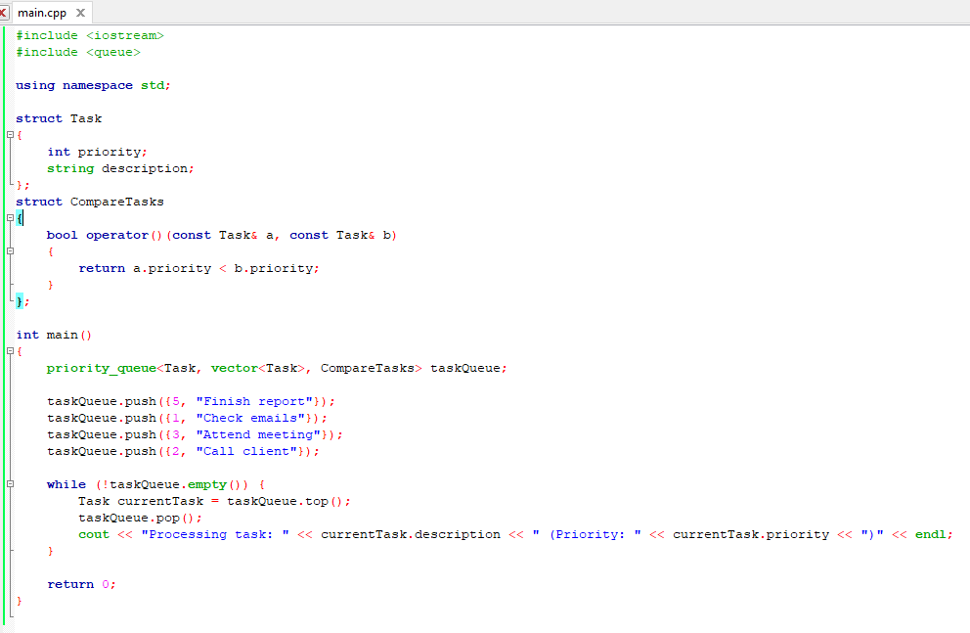
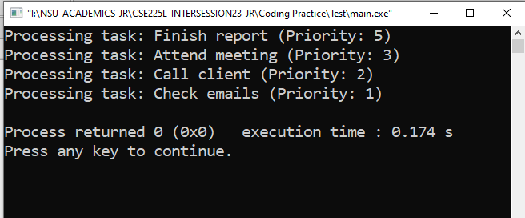
Heap-based

Slide 7
Binary search tree
Another efficient option, where elements are inserted and searched based on their keys and priorities.
Key Concept:
BST
Insertion
Removal

Slide 8
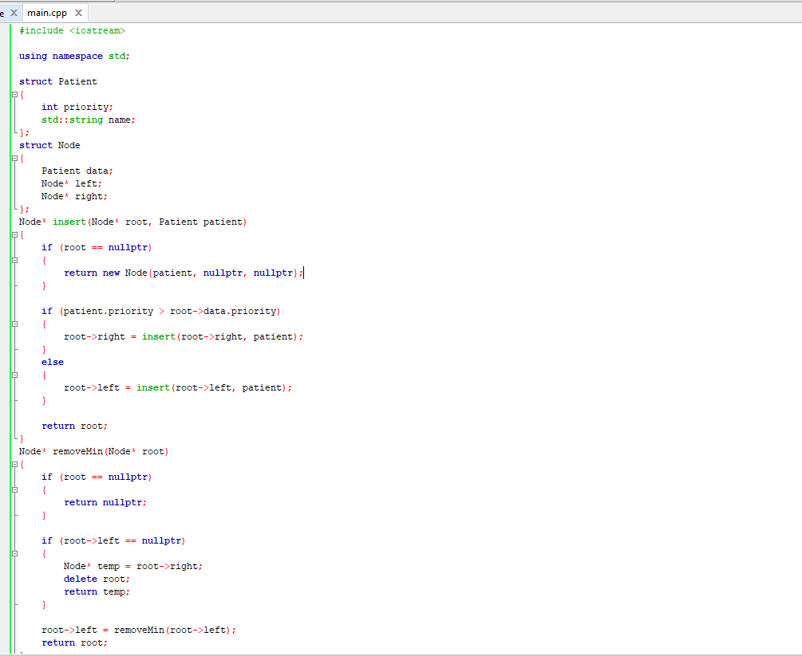
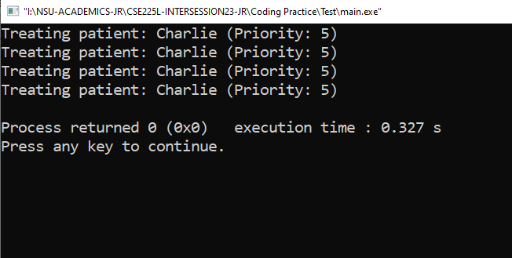
Binary search tree

Slide 9
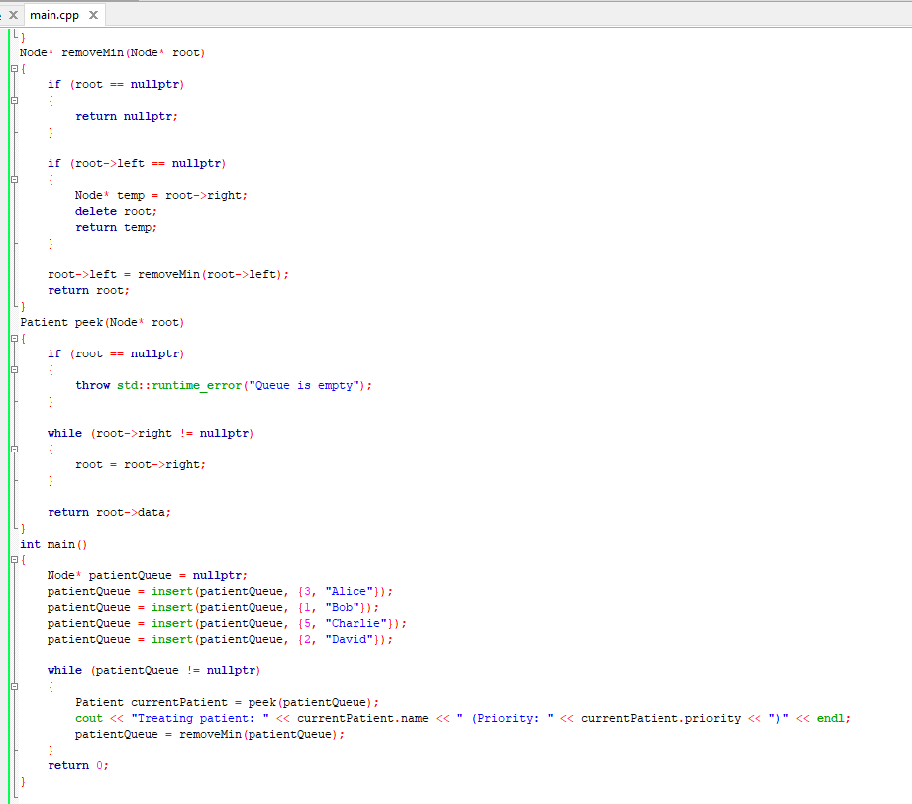
Binary search tree

Slide 10
Unordered array
Simplest implementation, but least efficient. Finding the highest/lowest priority element requires iterating through the entire array, making it unsuitable for large datasets.
Key Concepts:
Unordered Array
Insertion
Finding Highest/Lowest Priority
Removal

Slide 11
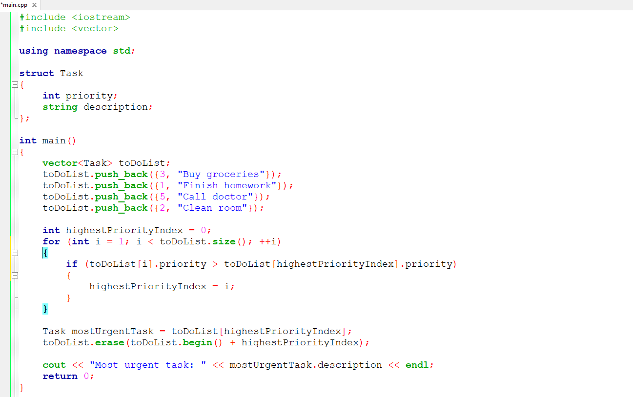
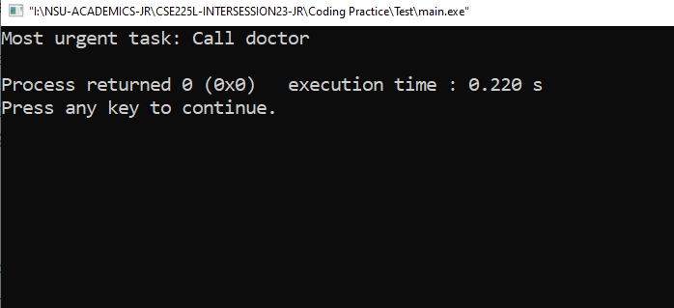
Unordered array

Slide 12
Implementation Comparison
Feature | Heap-based | Binary Search Tree | Unordered Array
Time Complexity | O(log n) | O(log n) | O(n)
Space Complexity | O(n) | O(n) | O(n)
Efficiency | Most efficient | Slightly less efficient for basic operations | Least efficient
Concurrent Access | Difficult | Possible with special BSTs | Simple

Slide 13
Real-World Applications
Healthcare:
Hospital triage
Ambulance dispatch
Surgery scheduling
Transportation:
Traffic signal control
Airport runway scheduling
Ride-hailing platforms

Slide 14
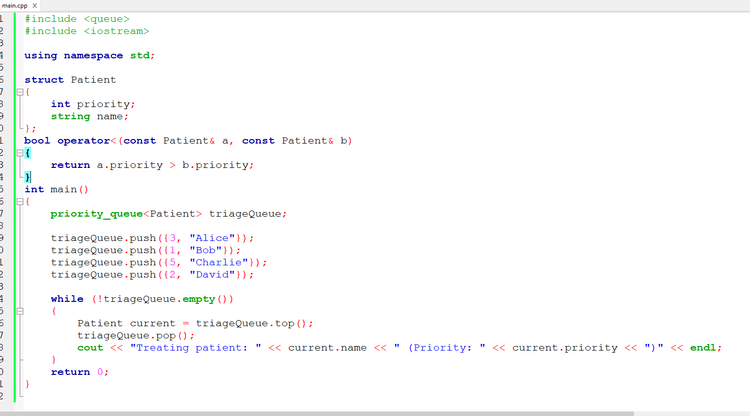
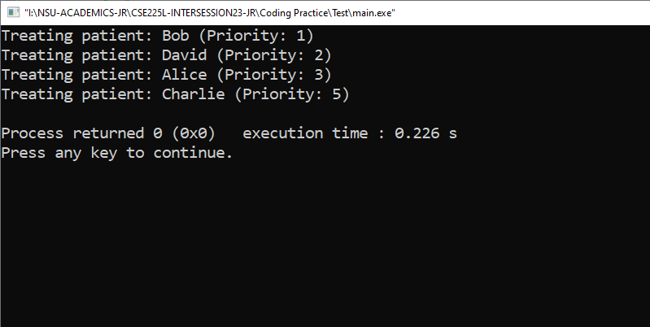
Real-World Applications
Hospital Triage (Heap-based implementation)

Slide 15
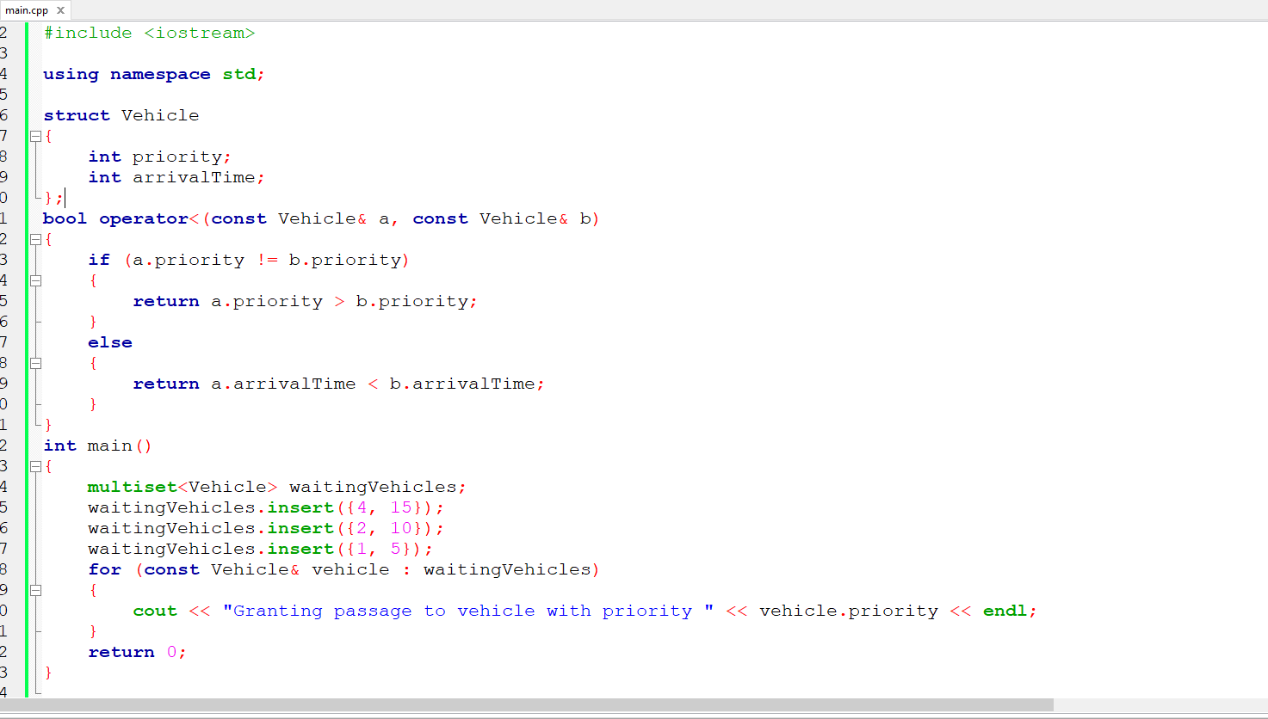
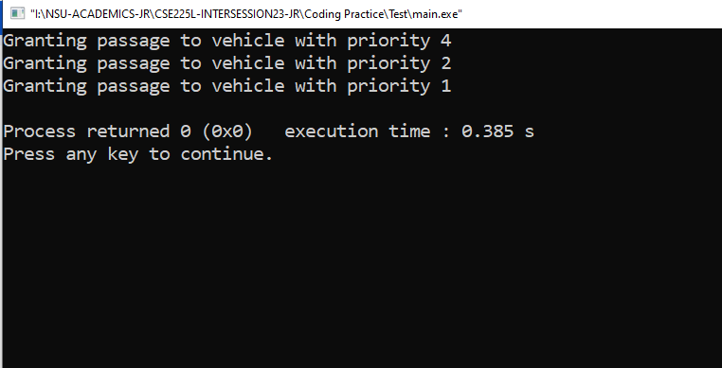
Real-World Applications
Traffic Signal Control (Binary Search Tree implementation)

Slide 16
Thank You

